Slide 1

Massachusetts State Employees’ Retirement System
You Serve the Commonwealth. We Serve You.
MACRS Fall 2025 Conference

Slide 2
Introductions
Kathryn Kougias, Executive Director
Prior to joining the MSRB, Ms. Kougias served for five years as Town Treasurer and Assistant Treasurer for a local municipality. For nearly 20 years, she served in various management roles with State Street Global Advisors, CitiStreet, and ING with a focus on retirement services that included Defined Contribution, Profit Sharing, and 401(k).
Sandor Zapolin, Deputy Executive Director & Chief Operating Officer
Prior to joining the MSRB, Mr. Zapolin worked as an Administrator with the Revere Retirement Board, the Minuteman Regional Retirement System, and a Review Examiner/Administrative Law Judge with the Department of Workforce Development.

Slide 3
MSRB Staffing Improvements
Implemented Employee Retention Program
Conducted Salary Analysis
Aligned positions to grades
Added appropriate management levels
Results...

Slide 4
Progress at MSRB
Change in Compliance
With Statutory Time Limit
First Pays
6.4% in 2022
77% in 2025
Refunds
52% in 2022
98% in 2025
Payments to Other Boards
44% in 2022
100% in 2025
Source: PERAC Audit, June 2025
2022
2025
2022
2025
2022
2025
“We hear plenty about the problems and the negatives in public service, and I wanted to take this opportunity to mark these exceptional achievements.” – Bill Keefe
Notes:
“Progress at MSRB” (preferably bar charts or something similar)
Staffing – 2023 – 70 employees, 2025 – 107 employees
First Pays – 2022– 134 days on average, 2025- 53 days on average (6.4% compliance to 77% compliance)
Refunds – 84 days on average to 16 days on average (52% compliance to 98% compliance)
Payments to Other Boards – 122 days on average to 32 days on average (44% compliance to 100% compliance)
Source: PERAC Audit, June 2025

Slide 5
Progress at MSRB
Process Improvements
Estimated Initial Benefit Payment
The first payment is issued to a retiree within 60 days of their retirement date. The EIBP calculation must meet criteria that is subject to plan rules.
Refunds Workflow
Dedicated resource for payments to other boards

Slide 6
Social Security and Section 218
Slides courtesy of Melanie Helmick, Oregon, NCSSSA Conference

Slide 7
The Executive Director of the Massachusetts State Employees’ Retirement System (MSERS) also serves as the State Social Security Administrator (SSSA) for Massachusetts.

Slide 8
History
State and local government employees may be covered for Social Security and Medicare either voluntarily or mandatorily.
If you are voluntary, you are covered under Section 218 of the Social Security Act.
218
If you are mandatory, you are covered under Section 210 of the Social Security Act.
210

Slide 9
History
In 1935, the Social Security Act was passed, and tax withholdings began in 1937. Under the original act, state and local government employees were excluded from coverage because of unresolved legal questions about the federal government’s authority to impose taxes on state and local governments and their employees.
In 1951, states could enter into voluntary agreements with the federal government to provide Social Security coverage to public employees (aka – Section 218 Agreement pursuant to Section 218 of the Social Security Act). Existing retirement systems were excluded at the time of signing. Political subdivisions of the state join the Section 218 agreement and enroll their employees in Social Security via a modification to the agreement.
On July 1, 1966, employees covered under a Section 218 Agreement were automatically covered for Medicare. In 1986, Medicare became mandatory.

Slide 10
The Process Roles and Responsibilities
SSSA receives an Inquiry
SSSA determines the eligibility of the Employer under the Massachusetts Agreement
Employer/Authority formally requests the State to enter into a 218 Agreement on its behalf
Employer/Authority gives eligible employees notice: not less than 90 days
A referendum is held by ballot, and the SSSA/designee supervises the process
Modification is prepared and submitted to the SSA
SSA approves within six months and is implemented retroactively to the start of the year

Slide 11
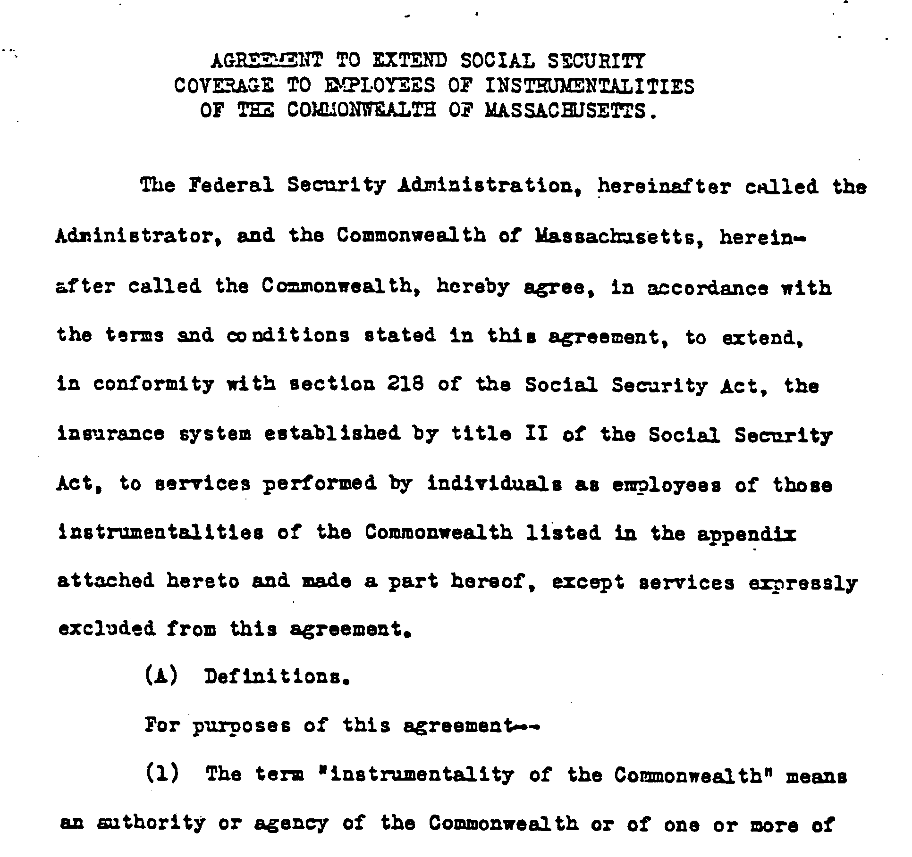
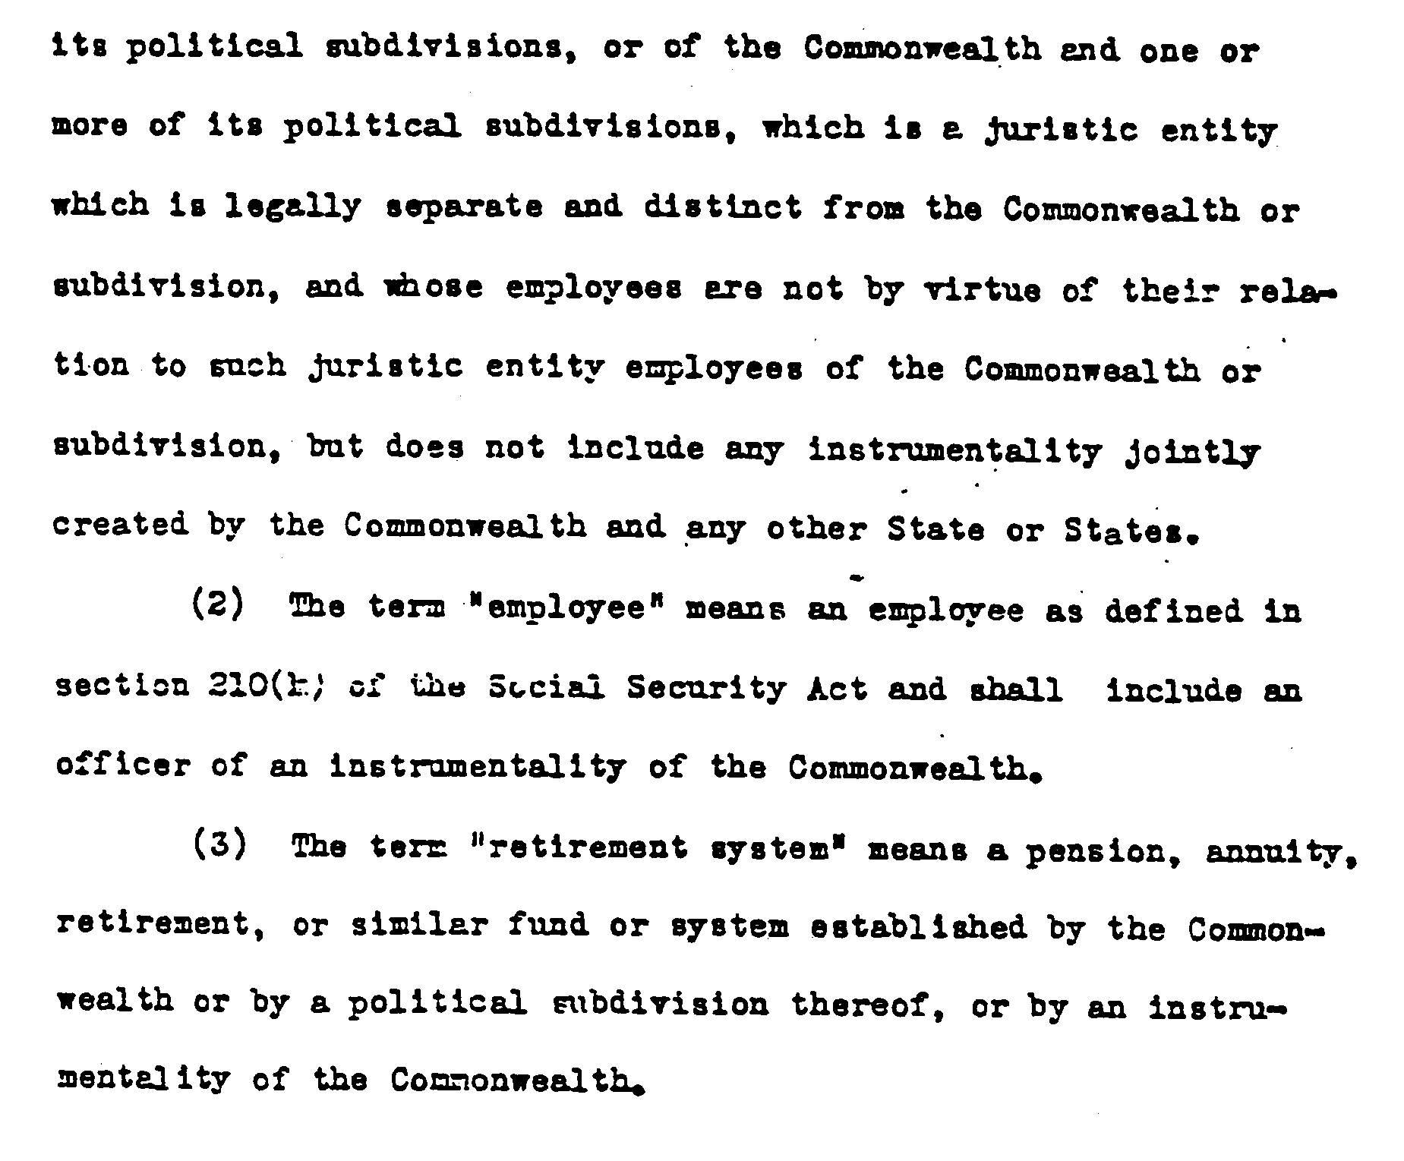

Slide 12
Section 218 of the Social Security Act: An Agreement between the State (State Board of Retirement) and Federal Security Administrator
Modification No. 1
Massachusetts Turnpike Authority, 1/1/1954
Boston Area Authority, 1/1/1954
Modification No. 2
Massachusetts Turnpike Authority, Terminated 3/1/1968
Modification No. 3
Massachusetts Health and Education Facilities Authority, 1/1/1971
Modification No. 4
Massachusetts Board of Overseers, 9/1/1974, Amended 6/29/1978
Modification No. 5
Springfield Parking Authority, 1/1/1987 (7 Employees)

Slide 13
Modification No. 6
Pioneer Valley Transit Authority, 10/1/1987 (14 Employees)
Modification No. 7
North East Solid Waste Committee, 1/1/1989 (3 Employees)
Modification No. 8
Greater Lawrence Sanitary District, 8/13/1952, Amended 11/1/1998 (5 Employees)
Modification No. 9
Montachusett Regional Planning Board, 8/13/1952, Amended 12/1/1998 (5 Employees)
Modification No. 10
Southeastern Regional Planning and Economic Development District, 8/13/1952, Amended 1/1/2003 (3 Employees)
Modification No. 11
Pioneer Valley Planning Commission, 8/13/2952, Amended 1/1/2003 (3 Employees)

Slide 14
Questions?
?

