Slide 1
MACRS Dec. 2025
Directors’ Roundtable

Slide 2
Veterans Deployment
What do you do when an Active member is deployed/activated to military service?
GL c. 32 s. 4(1)(h) mandates that this member shall receive full Creditable Service for the period of deployment, but not in excess of four years unless it is involuntary. (If it’s guard/reserves duty, it is involuntary, even if they choose to extend their deployment)
  Does your Board receive notification of deployment?
    Personnel Action Forms
    Military Orders – how long will this veteran be serving
      Is there a way to flag their return?
      Is the member being paid by the Employer?

Slide 3
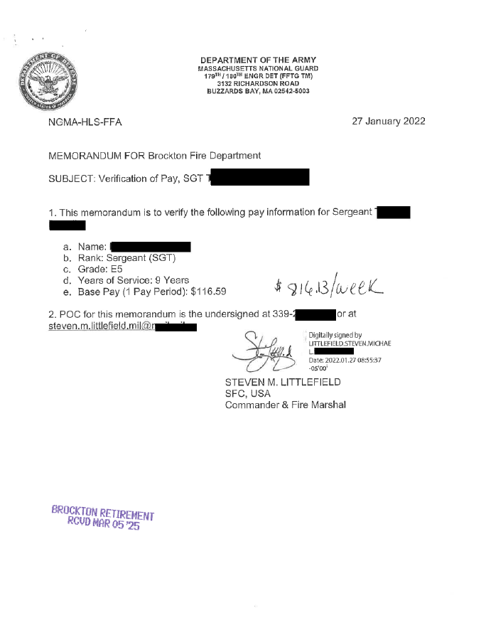
Example Military Orders:

Slide 4
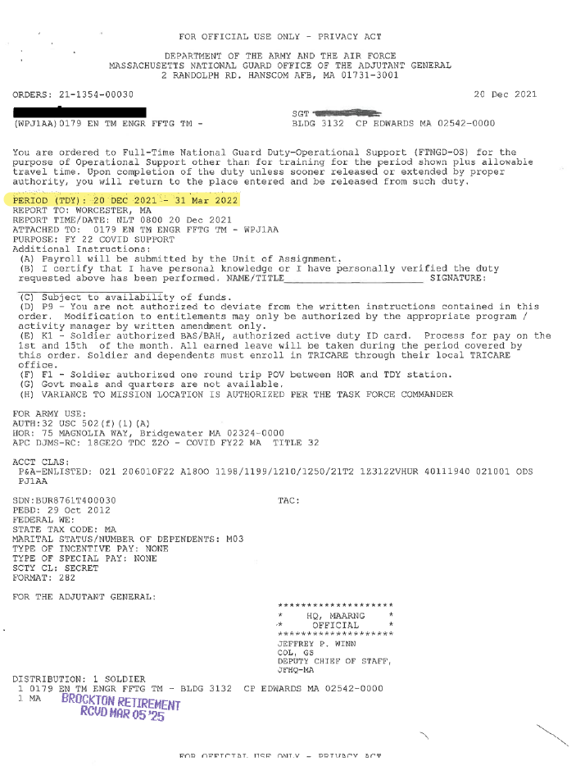

Slide 5
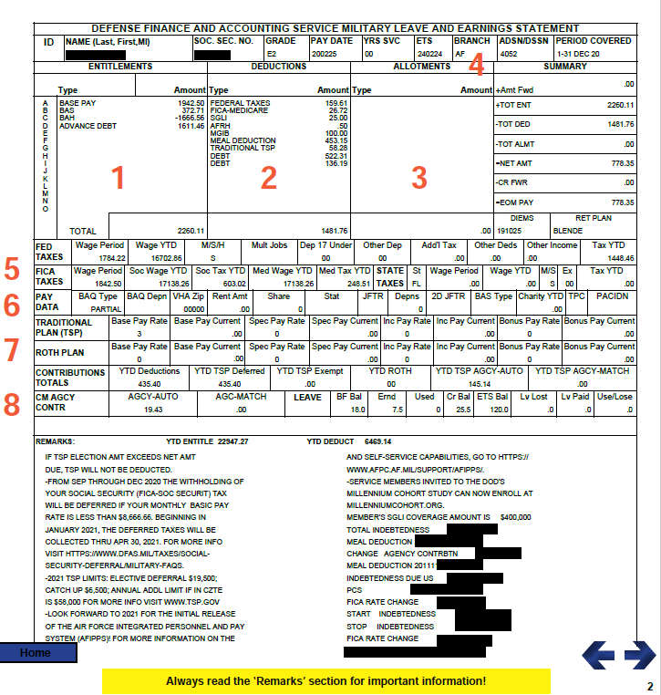
Leave and Earning Statement (LES) : Member should present to Dept Head, or payroll Department

Slide 6
We know our member is deployed, what do we do?
Member must receive creditable service
  Is there a module in the database that allows you to flag them as deployed?
  Keep an off-line schedule of those members that are deployed
Need to bill the Municipality/Authority for the deductions the member would have received if they were actively working
  How do I know how much to bill the Muni/Authority?
  Did your municipality vote the Military Pay Act?
  MGL Chapter 33, Section 59 provides paid military leave for Massachusetts public employees serving in the armed forces, entitling them to receive their regular pay without loss of seniority, vacation, or sick leave. This leave is for periods of service in the uniformed services, annual training, or drills, not exceeding 40 days in a federal fiscal year. For active duty missions, the first 30 consecutive days are also covered. The provisions of Chapter 137, Acts of 2003 were incorporated in updates of c. 33 s. 59 (d) and (f).
MAKE SURE ALL PAYROLL DEPTS. KNOW OF THE SPECIAL ACT.

Slide 9
Is your member receiving regular deductions?
If the member is getting paid regular pay the funds are going to their regular annuity savings card.
  Do nothing as system will continue to keep them as active and creditable service and deductions are recorded
If the member is receiving partial pay.
  Those deductions will still go to their regular annuity savings and service shall continue to accrue BUT …
    We need to collect for the rest of the deductions.
If the member is receiving no pay (military pay is higher than their regular earnings)
  The member still receives creditable service, but make sure software is keeping service intact.
  Board must calculate how much they should have been paid while deployed, and unpaid

Slide 10
4890- Military Service Fund
MGL. c 32 s. 22(7) – mandates that the Board calculate what would have been paid into the system
MGL. c 32 s. 22(4)(b)- When the member retires (or an eligible beneficiary receives 12(2)(d)), the amount in the Military Service Fund plus interest should be added to the member’s regular accumulated deductions and used in the calculation.
  If member refunds/dies prior to retirement with no eligible s. 12 beneficiary, then reduce the next year’s appropriation assessment by the amount in the member’s Military Service fund.
  If member transfers, original Board keeps the military funds on deposit and advises the new System. The transfer will take place upon retirement.

Slide 11
Example: GI Jane partial pay
9% and 2% member
Jane normally receives $52,000 annually from the municipality, ($1,000 wkly).
She is only receiving half pay while deployed
Normally Board receives $90 (9%) $8.46 (2%)
Board only received $45 0.00 *
* Most payroll systems only calculate the 2% if the weekly pay is > 576.92 weekly
The Military service Fund assessment will be $53.46 for each week that Jane was receiving her half pay.
When the Assessment is calculated we must send into the Actuary dept of PERAC for approval
When PERAC has approved, they will send a letter and then the Board will bill the Municipality/Authority

Slide 12
After we billed Municipality/Authority and Received Funds
Although these funds may be for a prior year the funds should be booked to the year the funds are received.
  J/E 1040 Cash $1,389.96
  4890 Military Ser Fnd Approp $1,389.96
Interest should be applied and this will stay in the members account until retirement, or refund.
Much like we have a supplemental schedule for 4891 we need to have a record for 4890.
  Database generated
  Off line schedule

Slide 13
Are You Capturing ALL of Your Members’ Deployments??
We discovered that some departments were terminating deployed members and then “re-hiring” upon return.
First order of business was to determine what members were actively deployed.
  We sent postcards to EVERY Member asking them if they have been deployed and to please contact our office as it could affect their service and retirement.
Work with your veterans’ agent to see if s/he will coordinate with the members and the payroll departments. Communication is crucial.

Slide 14
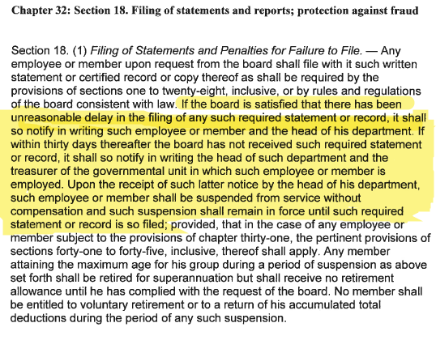
Does your Board have problems getting new members in to sign up for membership?
Other Issues
IRS FIRE system is retiring as of 12/31/2026. We can not file our 2026 1099s through FIRE
Has anyone applied for their IRIS TCC #
(Information Returns Intake System)
  What role did you apply under; Issuer or Transmitter?
  _________________________________________________

