Slide 1


Workers Comp
& Chapter 32
This Photo by Unknown author is licensed under CC BY-SA.

Slide 2


Workers Comp
What is it?
Notes:
In this presentation we will be going over the different role's workers compensation has in our day-to-day retirement.

Slide 3

According to the Massachusetts Department of Industrial Accidents (DIA) – It’s a system in place to make sure that workers are protected by insurance if they are injured on the job or contract a work-related illness.
Under M.G.L. Ch 152, Sec. 25A all employers are required to provide Workers Compensation (WC) insurance coverage to all their employees.
Long story short; through a process, in the end, the employer pays the employee a portion of their wages while they are injured and covers the cost of their medical treatment for such injury
Notes:
Now I could read you the law but no one wants that. Basically it’s benefit an employer supplies and pays to an employee when they get injured on the job due to a worked related injury.

Slide 4

Why do I care?
Its not my job - We only handle members retirements
Notes:
You’re probably saying, wow isn't that nice? If I get hurt on the job there is a nice benefit. But why do I care? I don’t handle workers comp claims; I just handle their retirements.
There are many reasons why we care about this as retirement board staff which is what I plan to go over.

Slide 5
Creditable Service
Section 34 = Total Temporary = Full Creditable Service
Section 34a = Total Permanent = Full Creditable Service
Section 35 =Partial = No Service!
Notes:
Creditable Service is one reason we care.
There are three different types of workers comp claims based on law. Sections 34, 34a and 35, and depending on which one the employee is getting benefits under depends if they get creditable service or not.
Section 34 = Total Temporary
Section 34a = Total Permanent
Section 35 =Partial

Slide 6
Common Questions
How do I know someone is on workers compensation?
How do I know what section they are being covered under?
Notes:
The two questions that will probably come next are how do I know someone is on workers compensation and how do I know what section they are being covered?
Now every system is different on what and how they get information. Im just going to jump into an example because I find that its easier when you have real life examples.

Slide 7







Example:
Dave is a DPW worker, his recent salary is below:
Jan -4,500
Feb – 4,500
Mar – 4,500
April – 4,600
May – 2,200
June – 0.00
July -0.0
Aug – 2,900
Sept – 4,600
Oct – 4,600
Call HR
Gets full service for that period
Salary drops
He was on workers comp, Section 34 from 05/15 to 08/15
Notes:
Lets look at an example. See Dave here. Dave is a sanitation worker and asked for an estimate. When we take a look, into our system, it seems there was period where he was in a no pay status recently.
So the drop in pay I want to know whats going on. Is he on sick leave? Did he have a job change? Was he a bad boy and suspended on unpaid leave? Or was he on workers comp?
There are a couple ways to find out. For me I look at the detailed daily salary. My city sends me detailed information and I can see the pay code itself.
After asking payroll it turns out Dave was being paid workers comp section 34 from May to August. It did not show up on your payroll because no contributions come in.
So because Dave was on section 34 total comp he gets full credit service for the time of May to June.
However if Dave was on section 35 partial comp he would not get the service and we would enter in a service break into his retirement account

Slide 8
Wait, there is more
Notes:
Its not just the service that workers comp affets, so does ones salary

Slide 9
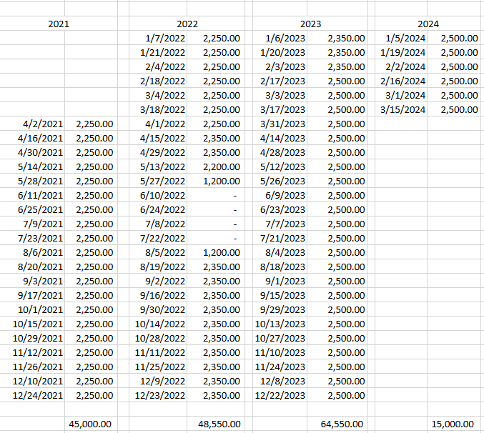
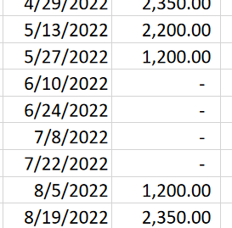
Example
Notes:
Lets Look at Dave again,
He asked for an estimate and planned to retire in March.
We noticed he had some drop in pay back in May through August. We called payroll and they told us he was on Total Comp Section 34 from May to August. how do we deal with this drop in pay?

Slide 10
What about salary and 3 (5) year average?
Section 5(3)(b)
When someone is on total comp and you're doing their 3 (5) -year average you need to consider their salary they SHOULD have been getting. Because they are getting service but there is no salary, section 5(3)(b) says to use the rate in effect prior to the absence.
Any duly authorized leave or period of absence for which any member is allowed creditable service under sections 1 to 28, inclusive, and any such leave or period of absence not in excess of 1 year for which such member is not allowed creditable service, shall be included in any applicable 3–year or 5–year period to determine the average annual rate of such member's regular compensation therefor to the extent such leave or period of absence falls within such applicable 3–year or 5–year period, anything in such sections to the contrary notwithstanding. In determining any such average annual rate of regular compensation for any member, the rate in effect for him immediately preceding any period of his absence without compensation shall be used as the rate for such period of absence.
Notes:
What about the Average?
Section 5(3)(b) of Chapter 32 addresses this.
In this situation dave was out on an authorized leave, that leave being section 34 workers comp, gaining creditable service. Because he was not getting any pensionable pay we are able to then take the salary in effect before his leave and bring it forward for the period of the absence.
So, lets do that

Slide 11
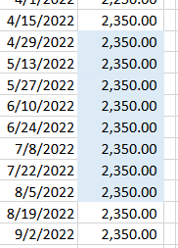
Example
Notes:
According to Section 5(3)(b) we can take the salary preceding his absence (which was 2,350 in this case) and bring it forward to the end of the absence period.

Slide 12
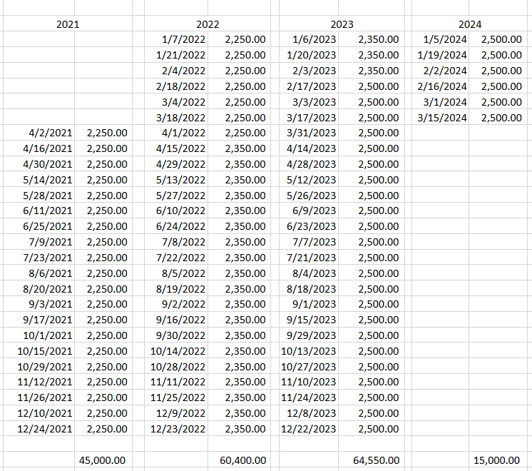
Example
Notes:
Therefore we go from the average on the left, to the one on the right which is much more accurate of his salary at that time.

Slide 13

Not everything is black and white

Slide 14
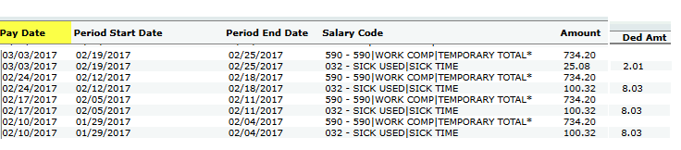
Supplemented Time
Workers Comp accompanied by Sick or Vacation time
Notes:
What do we do if someone had supplemented time?
What I mean is Workers' compensation that is accompanied by sick or vacation time the employee has.
We see this person was on Temporary total – so we know they get service. However, we see they also were using sick time to supplement that workers comp, and deductions came out.
So how does this effect their average. Do we just go off the sick time or do we adjust the salary like we did before?

Slide 15


VERNAVA
Sick/Vaca + Workers comp ≠ Regular Pay
Notes:
You may have heard of the Vernava case. Part of this case informed us that any time accompanying or supplementing workers comp is not considered regular pay.
So how does this affect our members average?

Slide 16
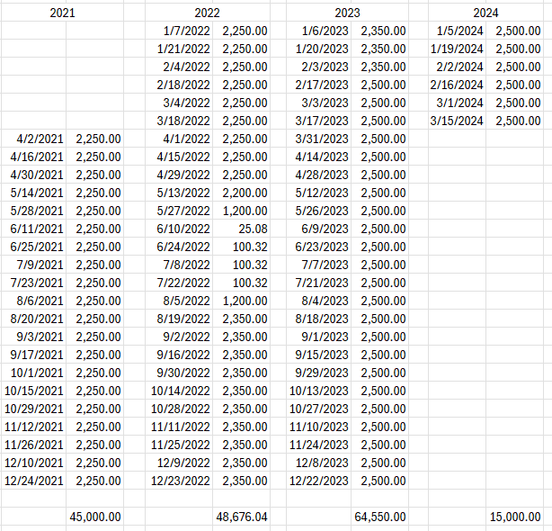
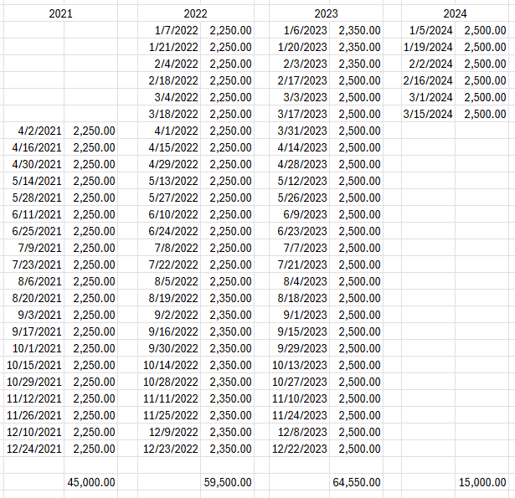
Example
Notes:
Let's bring back that member from before, only they have supplemented sick and comp time
For the average we treat this the same as before. Even though you have some sick and vacation time being paid, just overwrite it with what they should have been paid with the salary they were getting before they were out on comp. That doesn’t change.

Slide 17
Example
What if this was someone on partial workers comp?
?
Notes:
Now I am going to back up a bit, thats an example of someone on total workers comp and getting creditable service, What if someone is on partial workers comp?
They are using their own sick and vacation time to offset the partial comp, do they get service now?
Even if someone is on partial comp, and getting sick/vacation with that partial comp, its still not considered regular pay. The type of workers comp doesn’t matter, any supplemented sick or vacation with workers comp, regardless of the type = not regular pay, and still so service under partial comp

Slide 18
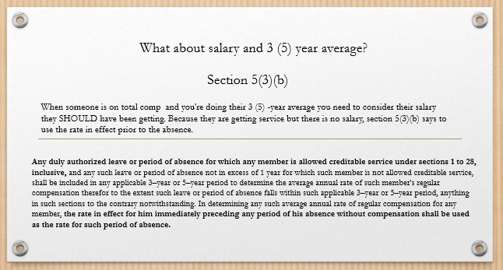

Not everything is black and white
Notes:
Back to our previous slide.
5(3)(b) states any leave where a member is not getting creditable service covered under sections 1 – 28, which accumulated to under a year of service, you could technically just bring the salary forward.
Otherwise you would just pick up the extra weeks.

Slide 19

Creditable Service
EXCEPTION!
Section 34 = Total Temporary = Full Creditable Service
Section 34a = Total Permanent = Full Creditable Service
Section 35 =Partial = No Service!
**If someone is on partial workers comp, and WORKING part time they do get
parttime credit for the time actually worked!**
Notes:
Lets rewind back to creditable service.
As we know, partial comp = no service. However…There is one situation where, you DO get service with partial comp.
Don’t see it often but its happened so I have to mention it.

Slide 20

Quick Note
VERNAVA
Sick/Vaca + Workers comp ≠ Regular Pay
Notes:
Back to our pal Vernava – Side note
Sick and Vacation supplemental pay is not regular compensation, but as we see before sometimes contributions come out of that supplemented time.
It shouldn’t. Payroll has missed it before for me, so I wanted to talk about what we do with those contributions.
Those must be refunded. So whenever you have someone who was on workers comp always make sure to check the deductions cause those have to go

Slide 21
Summary
See a break – ask why
If comp – what kind – service?
If service – no break - Carry forward salary
If supplemented sick/vaca– refund deductions
Partial = no service unless supplemented with REG pay PT Work
Notes:
And that’s basically it

Slide 22
Wait, there is even more
Disability Retirement and Workers Comp
Notes:
Except its not.

Slide 23
Disability Basic
ADR = 72% 1Yr Salary + annuity
Became a member after 1988, or hired before 1988 with broken service
  Limited to 75% total ADR benefit
    72% + Annuity = capped at 75%
Notes:
Disability Basic, a member ADR benefit is 72% of a 1 year salary plus their annuity.
However, if someone who became a member after 1988 OR if you have someone hired before 1988 but has broken service, the total disability benefit is limited to a maximum 75%
Why does this matter? Well buckle up its about to get complex, right before lunch.

Slide 24
Workers Comp Deductions
ADR Disability and on workers comp = added annuity known as
Workers Comp Deductions.
This only applies to total comp, sections 34 and 34a . Not partial.
Notes:
When someone is on workers comp, and are retiring under a disability, in certain situations you award them with Workers Comp Deductions.
What are workers comp deductions? Essentially you take the time they were on workers comp, and you figure out WHAT they should have been contributing during that time.
This only applies to total comp, sections 34 and 34a . Not partial.

Slide 25
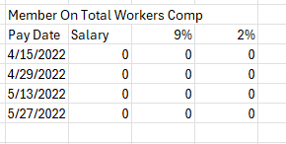
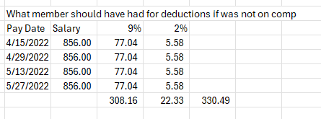
Workers Comp Deductions
ADR Disability and on workers comp = added annuity known as
Workers Comp Deductions.
Notes:
What are workers comp deductions? Essentially you take the time they were on workers comp, and you figure out WHAT they should have been contributing during that time.
And add those contributions to their annuity
So in this example this person was on total temporary comp for about 4 weeks. I figure out if they weren’t on workers comp they would have contributed 330.49.
I add that 330.49 to their annuity, This money comes out of the pension account. The goal of this is, is to increase a members pension.
Because GENERALLY someone who is going out on a disability is someone who hasn’t contributed as muc has they could because they are out of work due to that injury., and as we know you don’t contribute on workers comp, and any deductions coming out of sick and vacation pay is not regular pay and gets refunded. So if a member goes out on disability, they are at a disadvantage in that aspect.

Slide 26
Check for Cap!
75% Cap
If a member is not subject to the cap, then you need to calculate how much in deductions they should have received for their full pay while they were on workers comp, then add that to their annuity, ergo providing them a higher benefit.
If a member is subject to the cap you first must check if their benefit has already reached 75%, if not, then you award the deductions
Notes:
But before you awarded the deductions, you have to check for the 75% cap.
Again, the goal of awarding these deductions is to increase the member's pension. So, The additional deductions have to increase the member’s
Allowance for them to be awarded.
If someone is not subject to the cap, you just award them.
Someone who is hitting the 75% Accidental Disability limit will not be credited with them, meaning before you even add in the added deductions, they are already at 75% when you calculate their Disability benefit, you don’t award them because it doesn’t help.
But when you have someone who is subject to the Cap, and when you calculate their disability, they are not hitting that 75%, you can then go in and award and add in the deductions because it will increase their benefit.

Slide 27


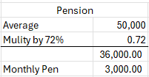
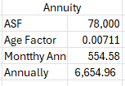


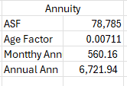
Example 1 – Not Capped at 75%
Notes:
First example
We have Dave, he is 56 and hired before 1988 with no breaks in service, so his benefit is not capped at 75%
His average is 50K and his annuity is 78K and we calculated he could be awarded with $785 in workers comp deductions
When we calculate his benefit without the deductions he is at an annual 42,654.96
When you re calculate and add the 785 to the annuity his benefit increases to an annual 42,721.92
You would award these deduction because

Slide 28


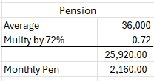




Example 2 – Capped at 75%
Notes:
Second example
We have Fiona, she is 40 and hired after 1988 , so her benefit is capped at 75%
Her average is 36K, annuity is 12K and her additional annuity would be $1,225.
Her benefit is capped at 75% which would be 27,000
When we calculate her benefit without the workers comp deductions she is at an annual 26,804.16. This is not reach the 27,000 cap.
So when you re calculate and add the 1,225 to the annuity her benefit increases to an annual 26,894.40. It is still not at the cap but her benefit does increase,
You would award these deduction because she benefits from the additional annuity

Slide 29


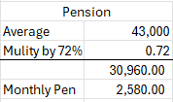




Example 3 – Capped at 75%
Notes:
Final Example
We have Luke here and he was hired after 1988 , so his benefit is capped at 75%
His average is 43K, annuity is 30K and his additional annuity would be $2,000
His benefit is capped at 75% which would be 32,250
When we calculate his benefit without the workers comp deductions he is at an annual 33,390, this is OVER the 75% cap.
So his benefit is limited to a max of 32,250
His pension is modified to a monthly 2,485.00 and his annuity would stay at 202.50 for a total monthly of 2,687.50 which annually is 32,250.00
He does not get the additional annuity awarded because he is already at the maximum benefit

Slide 30
Wait, there is more math
Notes:
Its not just the service that workers comp affets, so does one's salary

Slide 31
M.G.L. c. 32, s. 14(2)§
Once a member is retired with a disability benefit AND is also receiving a worker's comp benefit, their Disability pension is then subject to be offset by that workers comp payment.
Notes:
PER MGL Chapter 32 s. 14(2)
If a member is retired with a disability benefit AND is also receiving a worker's comp benefit, their Disability pension is then subject to be offset by that workers comp payment

Slide 32
Example
Sally was approved for a disability pension; her pension is a monthly $3,150.
Sally is also receiving workers comp for a weekly payment of $385.00
Due to this Sallys disability pension is subject to the following offset.
385 * 52 Week = 20,020 / 12 months = 1,668.33. Where Sallys pension is subject to a 1,668.33 monthly offset:
Pension: 2,538.00
Annuity: 612.00
Comp Offset: [1,668.33]
Total Monthly Check: 1,481.67
Note only pension is subject to the offset, a member must be paid their annuity
Notes:
Only pension is subject to an offset

Slide 33
Example
Jose was approved for a disability pension; her pension is a monthly $3,150.
Jose is also receiving workers comp for a weekly payment of $602.00
Due to this Jose’ disability pension is subject to the following offset.
602 * 52 Week = 31,304 / 12 months = 2,608.67 Where Jose’s pension is subject to a 2,608.67 monthly offset:
Pension: 2,538.00
Annuity: 612.00
Comp Offset: [2,608.67]
Total Monthly Check: 541.33
Instead:
Pension: 2,538.00
Annuity: 612.00
Comp Offset: [2,538.00]
Total Monthly Check: 612.00
Note only pension is subject to the offset, a member must be paid their annuity
Notes:
Only pension is subject to an offset so if we look at somone else, Jose, his workers offset comes to an amount that is more than his monthly pension
You cannot offset the annuity. So you adjust the workers comp to whatever the pension amount is.
You want to make note to keep track of offset changes because sometimes peoples rates will change, effecting their retirement benefit.
I get a weekly report from HR showing me how is on workers comp and what their rates were for that week and we check it weekly to keep track of rate changes for the month.

Slide 34
Retro Payments
Disability Retro payments are also subject to a worker's comp offset.
If a member's disability was awarded in June of 2024, but the retro date of retirement is May of 2022, then when calculating that retro payment, any workers comp payments made during that time peroid must offset that retro payment
Notes:
Disability retro payments are also subject to workers comp offsets

Slide 35
Lump Sum Settlements
M.G.L. Chapter 32 Section 14(2)
When a disability pensioners workers comp claim settles, they are awared a lump sum payment.
The Retirement Board is due a portion of that payment.
(2) Workers' Compensation Benefits Offset. — (a) All sums of money payable under the provisions of sections thirty-one, thirty-four, thirty-four A, thirty-four B, thirty-five and thirty-five A of chapter one hundred and fifty-two directly to a retired member or to the legal representative or dependents of a deceased member on account of his death, including so much of the amount of any lump sum settlement payable under the provisions of such sections directly to any such person as is allocable to the period following the retirement or death of such member, but excluding any payments for or amounts allocable to any period prior to the date his retirement allowance became effective, shall be offset against and payable in lieu of any pension payable on his account under the provisions of section six, seven or nine by reason of the same injury, but not against his accumulated total deductions or any annuity derived therefrom. Whenever the amount of any such lump settlement is payable directly to a beneficiary, the period over which it is allocable for purposes of this section shall be determined by the actuary in a manner which is consistent with that set forth in paragraph (1)(c) of this section. If any such pension exceeds the compensation payable on account of such member under such provisions of chapter one hundred and fifty-two when both are reduced to the same periodical basis, the excess only shall be paid as a pension so long as such compensation continues. If any such pension is less than or equal to such compensation, no pension shall be paid so long as such compensation continues to be equal to or greater than such pension
Notes:
When a disability pensioners workers comp eventually gets settled and a lump sum payment is paid, the Retirement Board is due a portion of that payment that is attributable to wages
There is no statutory amount that is attributable to wages - you should make your member aware there is an offset with any lump-sum settlement, and tell them (or tell them to tell their attorney) to reach out to Retirement Board counsel before the lump sum settlement is submitted to the DIA for approval so that the Retirement Board’s interests are protected.

Slide 36
Section 14A – 3rd Party Claims
When a member who is retired of a disability benefit also gets a settlement form a 3rd party due to their work injury they retired from, the Board can also claim a portion of that settlement as well.
Notes:
Section 14A when in addition to WC, there is a third party claim , the Board is also entitled to a portion of that settlement.
Once again, there is no statutory amount, it is subject to negotiation, so get your Retirement Board counsel involved!

Slide 37


END
THANK YOU!
POSKEL@WORCESTERMA.GOV
Notes:
We have reached the end. That’s all I know about workers comp and I hope some of it was helpful
No questions because its time for lunch and I know everyone is eager to go, so if you have questions come find me or email me!
Thank you!

