Slide 1
Discussion topics
Cyber Exposures
Cost of Risk & Claims Examples
Cyber Policy - Structure
Controls – Insurance Perspective

Slide 2
Cyber Exposures

Slide 3
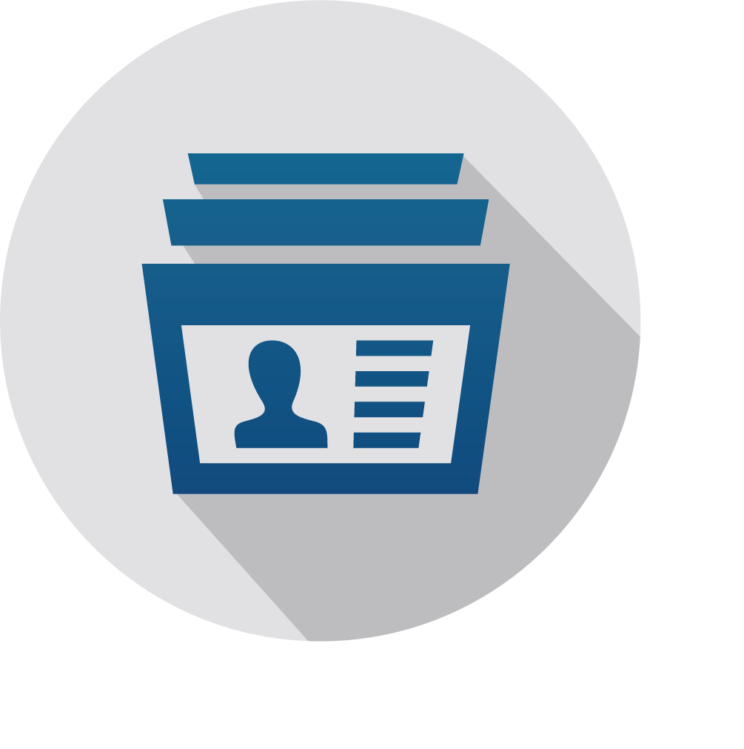
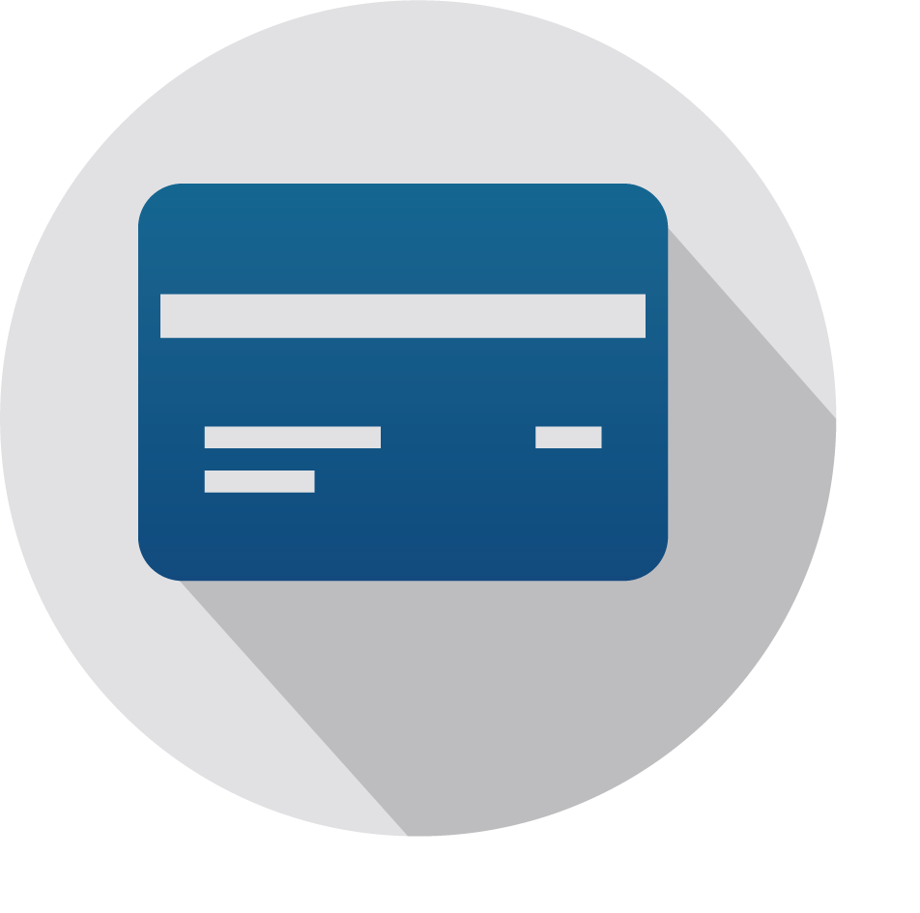
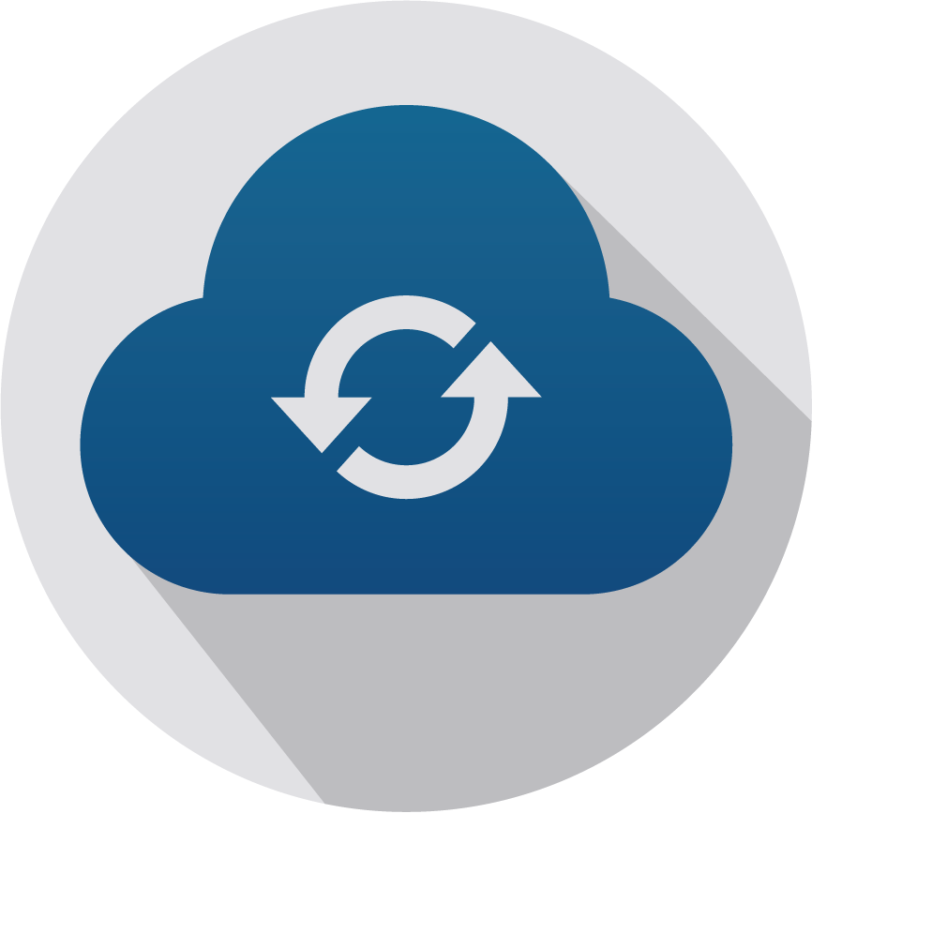
Threat landscape | risks & exposures
DATA RISK
OPERATIONAL RISK
PERSONALLY IDENTIFIABLE INFORMATION (PII)
Social security numbers, drivers license numbers, bank account information, online account user names, passwords and health insurance information.
PROTECTED HEALTH INFORMATION (PHI)
Any information about health status, provision of health care, or payment for health care that can be linked to a specific individual.
PAYMENT CARD INFORMATION (PCI)
Debit and credit card information such as the primary account number, cardholder name, expiration date and service code.
CONFIDENTIAL CORPORATE INFORMATION
Confidential information entrusted by third-parties, oftentimes subject to non-disclosure or confidentiality agreements.
Data Loss & Extortion
Computer Forensics Expenses
Cyber Extortion / Ransomware Payments
Data loss and Restoration
SOCIAL ENGINEERING & INVOICE MANIPULATION
Fraudulent instructions inducing employees to wire funds
Disguised communications posing as YOU inducing customers
BUSINESS INTERRUPTION / DEPENDENT BI
Malicious attack or system failure affecting YOUR network
Malicious attack or system failure affecting a DEPENDENT PROVIDER
Oftentimes a result of RANSOMWARE attacks

Slide 4
Data-RISK expenses
NOTIFICATION AND IDENTITY MONITORING
PCI FINES / PENALTIES / ASSESSMENTS
Liabilities
Costs to identify size/scope of event
Costs to notify affected individuals
Costs to provide credit/identity monitoring
Costs to work with regulators
50 different state data breach laws
- HIPAA
- NY DFS
*Exposure not outsourced with cloud providers*
Payment Card Industry – Non-Governmental Body
Fines/Penalties for non-compliance with PCI-DSS
Assessments delivered by Merchant Banks for Card Reissuance expenses and Fraudulent Charges
Responsibilities for loss of third-party data
Breach expenses experienced by third-parties (e.g. HIPAA - Business Associates)
Legal costs, defense, e-discovery
Settlements for identity theft, emotional distress, economic damages

Slide 5
MA Security Breach Notice Law, Update in Wake of Equifax Breach (Jones Day)
Four Key Takeaways
Companies reporting security breaches under the amended Massachusetts data breach law must disclose more information to regulators and consumers.
Notification letters will be more readily available to the public.
Companies must provide 18 months of credit monitoring services at no cost to Massachusetts residents whose Social Security numbers are disclosed in a breach.
Companies that own or license personal information of Massachusetts residents should implement, and where necessary, update a WISP (written information security policy) satisfying the Massachusetts legal requirements.

Slide 6
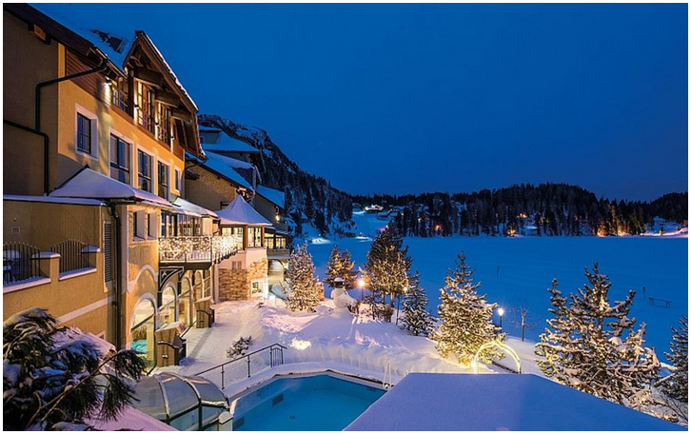
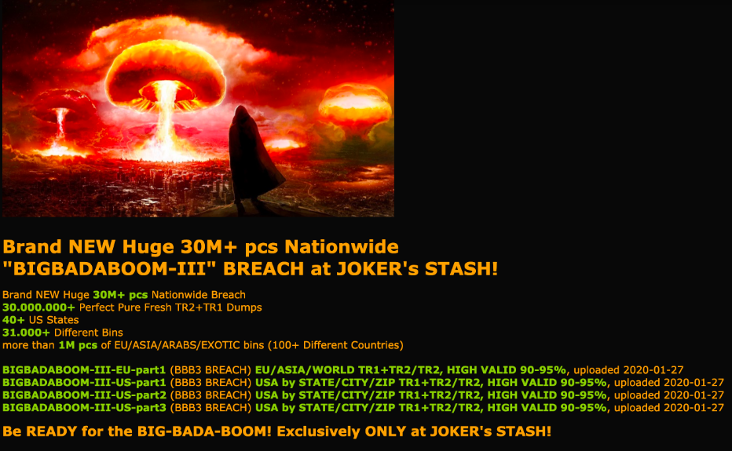
THE COST OF RISK | Breach & business interruption
Colorado Department of Transportation refused to pay a ransom of 3btc demanded by SamSam malware. Total recovery expenses were $1.5M
notPetya Ransomware:
Cyber Attack costs could hit $300M for Shipping Giant Maersk
Three hospitals of the DCH Health System in Alabama hit by ransomware on October 1, 2019, forcing the medical institutions to turn away noncritical patients while they work to restore systems.
Romantik Seehotel Jaegerwirt in Austria targeted by hackers, affecting the key card system resulting is all guests being unable to enter rooms.
Third-party billings collections firm American Medical Collection Agency (AMCA) suffered breach of 7.7M LabCorp and 12M Quest patients. AMCA filed for bankruptch shortly after.
In December 2019, convenience store chain Wawa disclosed a nine-month-long breach of its payment processing systems that leaked 30M+ payment cards from over 850 locations nationwide.

Slide 7
Total Breach Costs – Lost Business, Breach Response, Post Breach Costs (Ponemon/IBM Security)
Total Cost - Millions
Per Record - USD

Slide 8
The cost of risk | Funds Transfer Fraud
FUNDS TRANSFER FRAUD | SOCIAL ENGINEERING | INVOICE MANIPULATION FRAUD
Fraudster breaches or otherwise obtains credentials to accounts belonging to the business. | Fraudster issues communications intended to dupe an employee utilizing various confidence tricks. May pose as a client, fellow employee, or company executive. | Fraudster gains access to executive or employee’s e-mail account
Fraudster initiates wire transfer payments to accounts of their choosing, draining company funds. | Employee releases funds thinking they are following legitimate instructions. | Fraudster issues an invoice for payment to a client or vendor of the company, posing as the company employee. The invoice may be for a bill due or a “correction” to a previously sent invoice that directs funds to be paid to the hacker’s account of choice.
 | * Standard ‘Crime’ insurance policy lacking a Social Engineering grant declines to cover the claim due to the employee’s “voluntary parting of title”. | Company’s client or vendor transfers funds, following the instructions delivered from the company’s e-mail. Later, it is discovered that the funds went to the hacker’s account.
 |  | * Social engineering insurance declines coverage due to the funds not being transferred by the company.

Slide 9
The cost of risk | Data breach and social engineering costs
Specialized Cyber/Privacy Attorneys | $650 per hour
Investigation/Computer Forensics Fees | $300 - $700 per hour
Notification Costs (legal drafting and postage) | $1.50 - $3.00 per customer
Credit/Identity Monitoring Costs | $9.00 - $12.00 per redemption
Public Relations Firms | $10,000/month or $400/hour
PCI Fines/Penalties | Wide range, but usually 6-figures
Visa Global Compromised Account Recovery Program | $2.50 per card
Fraudulent charges on stolen cards | Moving Target
HIPAA Fines/Penalties | Recently ranging from 6-figures to $2.5M
Social Engineering / Wire Transfer Fraud | Analyze average and largest transfer amounts. Worse if exploited multiple times.
Invoice Manipulation Fraud | Analyze average and largest transfer amounts. Worse if exploited multiple times.

Slide 10
The cost of risk | business continuity
Investigation/Computer Forensics Fees | $300 - $700 per hour
Cyber Extortion Ransom Demands | Soaring to 7-figures
Business Interruption Losses | Income lost and extra expenses experienced during downtime
Data Restoration Expenses | $200 + per hour (Or worse if data cannot be recovered)
Hardware Bricking/Replacement | Cost of new servers, desktops, or other bricked equipment
Reputational Harm / Customer Attrition | Income lost in the months following a network recovery due to angered customers
Utility / Toll Fraud, Cryptojacking | Unauthorized use of telephone systems or cloud computing environments

Slide 11
Cyber Policy
Structure

Slide 12
Cyber policy structure | GENERAL COVERAGES
BREACH COSTS
Covers forensic costs to identify and confirm the breach, notification costs, credit protection services fees, crisis management and public relations costs.
CYBER BUSINESS INTERRUPTION
Covers financial loss, such as business income when network-dependent revenue is interrupted.
*Coverage variations discussed further
DATA RESTORATION
Covers the costs to recreate or repair damaged or destroyed data, systems or programs.
PRIVACY & NETWORK SECURITY
Covers defense costs, judgements, settlements, and regulatory fines/penalties arising from network security and data breach events.
CYBER EXTORTION
Covers the response costs and financial payments associated with network-based ransom demands.
MULTIMEDIA LIABILITY
Covers the costs to defend and resolve claims related to online content, such as copyright / trademark infringement.

Slide 13
Cyber policy structure I Additional Coverages
SYSTEM FAILURE
Non-malicious trigger business interruption coverage.
DEPENDENT SYSTEM FAILURE
Non-malicious trigger business interruption coverage for an event at a dependent IT provider.
DEPENDENT BUSINESS INTERRUPTION
Malicious event triggers a business interruption event at a dependent IT provider (cloud/ hosting, software, etc.).
SOCIAL ENGINEERING
Ensure no call-backs, check for coverage of ‘other property’ and scope of who’s funds are covered.
CLIENT ACCOUNT/INVOICE MANIPULATION COVERAGE
Third-party social engineering coverage triggered by fraudulent invoices being sent from insured’s e-mail.
FUNDS HELD IN ESCROW
(SOCIAL ENGINEERING / PHISHING)
Some policy forms only cover ‘your’ funds, not the funds of others in your possession.
UTILITY FRAUD
Telephone toll fraud, Cryptojacking; Unauthorized use of your systems.
Non-Breach Data Laws
Newer coverage available to cover claims arising from the misuse of data, rather than the breach of data (CCPA).

Slide 14
Controls/Loss Prevention – Insurance U/W Perspective
Remote Desktop Protocol (Estimate half of Ransomware events stem from open RDP ports)
Unused ports closed
Open ports protected with MFA
MFA – Multi Factor Authentication (thumbprint, text, phone token, etc). Network access, email access, software access.
Data management strategy – store and segregate by sensitivity of data.
Multiple servers and redundancy in client data. One breach should not wipe out all data in one spot.
If outsourcing data management, put proper controls in place for access and segregation.
Endpoint Detection and Response (EDR) monitor any device connected to a network (doors and windows to a network). Can contain malicious activity to one device.
Regular backups. Daily and segregation. 3-2-1. 3 Copies, 2 devices/media types, 1 off premises.
Attitude toward risk management. One person accountable? Open to suggestions?

